Slide 1
Shadow Mapping
...........................................................................
Alba Navarro Rosales
January 27, 2021
Churchill College CompSci Talks
Notes:
≈ “Have you ever played a 3D computer game (or seen a 3D C.G. app) & wondered how they achieved so realistic shadows in the scene? Well, shadow mapping is the answer to that.”

Slide 2
Outline
Lights & Shadows
What is Shadow Mapping?
OpenGL rendering pipeline overview
Method
Artefacts that occur
Demo time! :)
Shadow Mapping in context
Summary – key takeaways

Slide 3
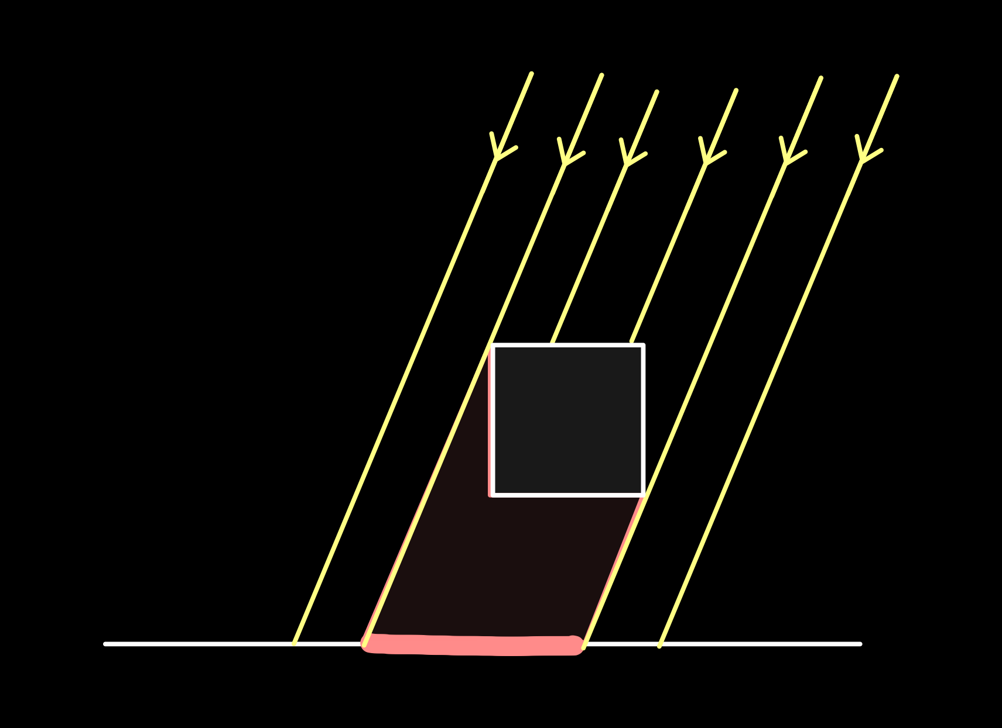
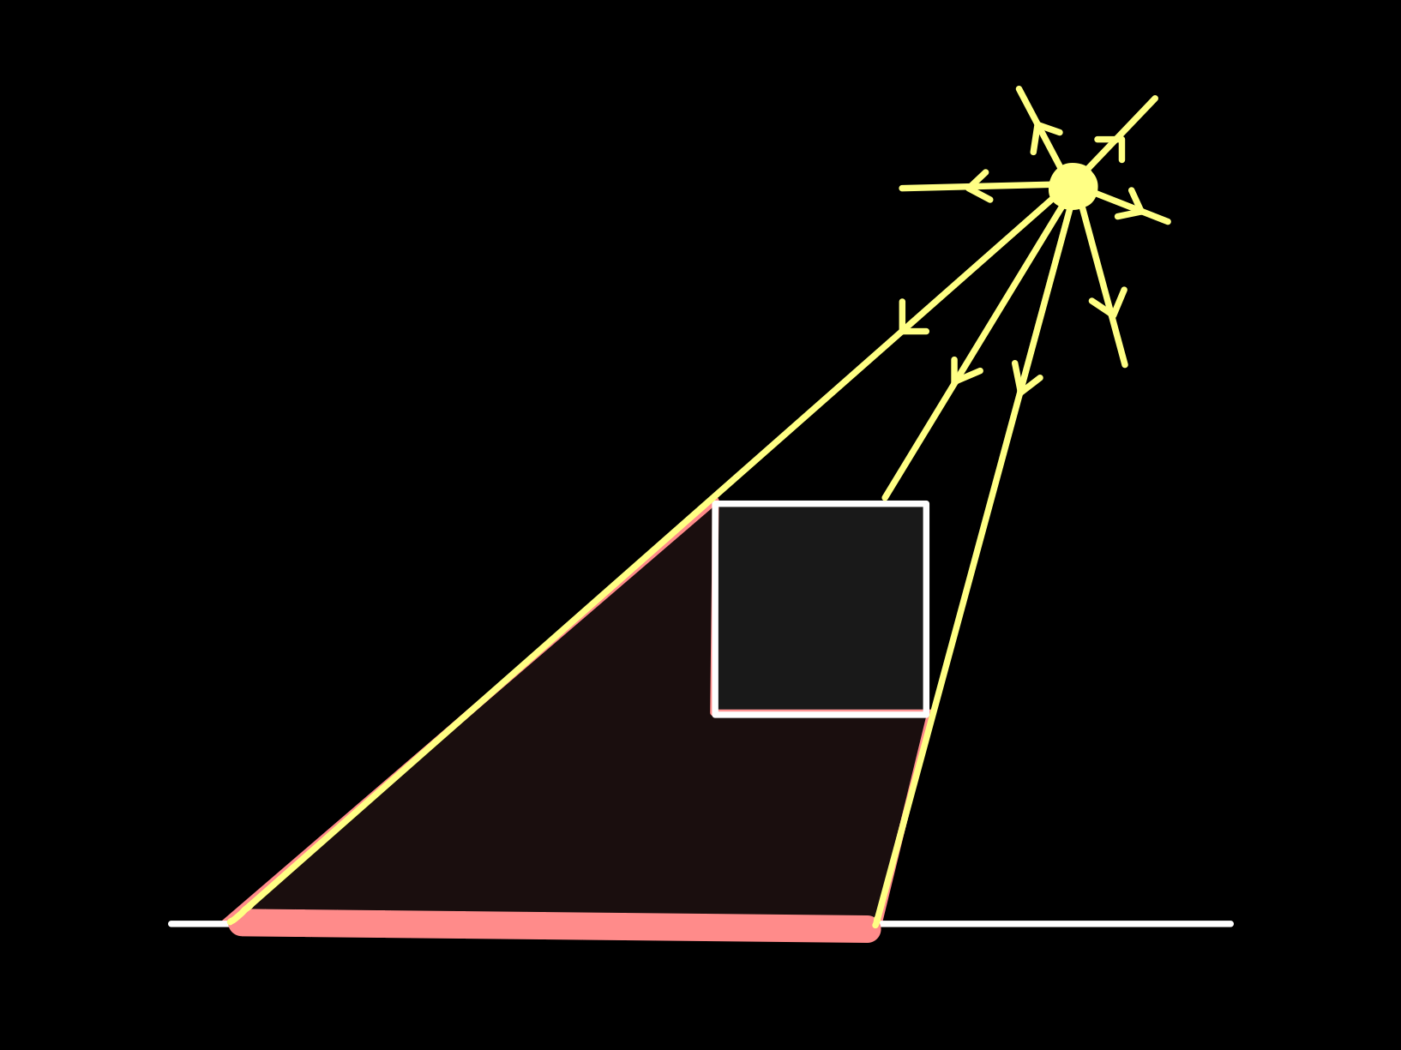
Lights & shadows
Shadows…
Add realism
Convey depth
Convey spatial relationships between objects
Different lights cast different shadows
Directional Light:
Point Light:
Orthographic Projection
Perspective Projection
Notes:
Mention that here we’ll focus on *hard* shadows only (from directional & point lights), not in soft shadows (from area lights).
“projected shadow has a … proj”

Slide 4
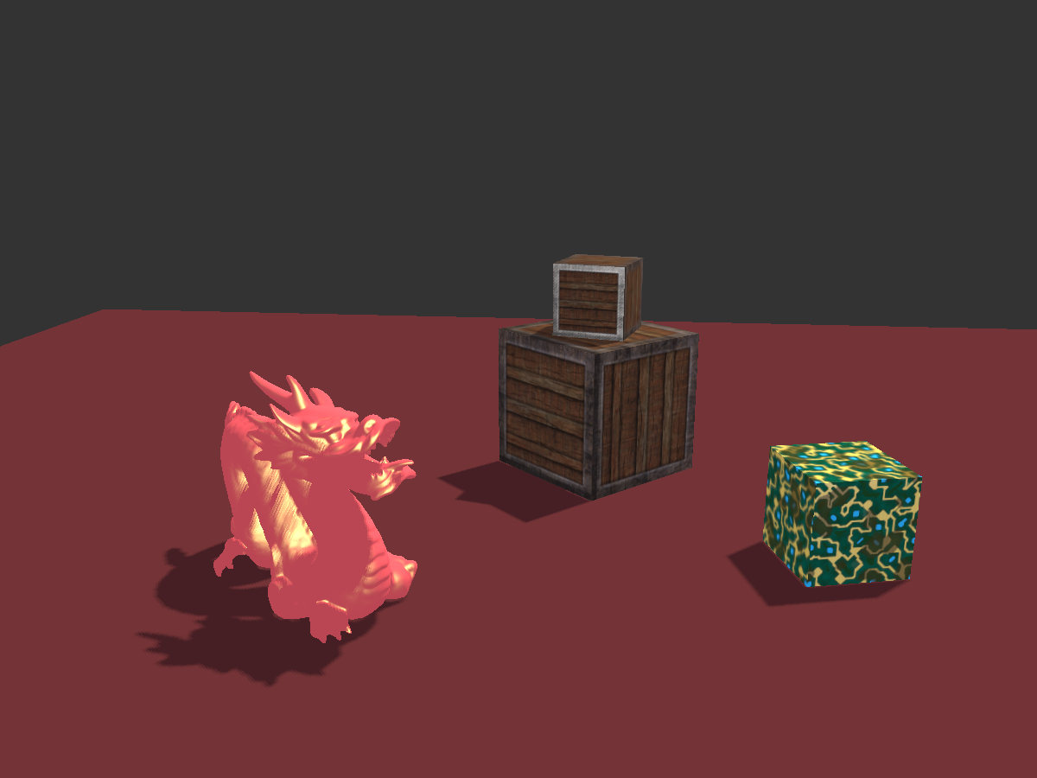
Shadow Mapping
A technique for rendering shadows in real-time 3D graphics
2 pass algorithm:
Generate Depth Map by rendering scene from light’s POV
Render scene from camera’s POV…
…using generated Depth Map to determine if fragment is lit
or in shadow

Slide 5
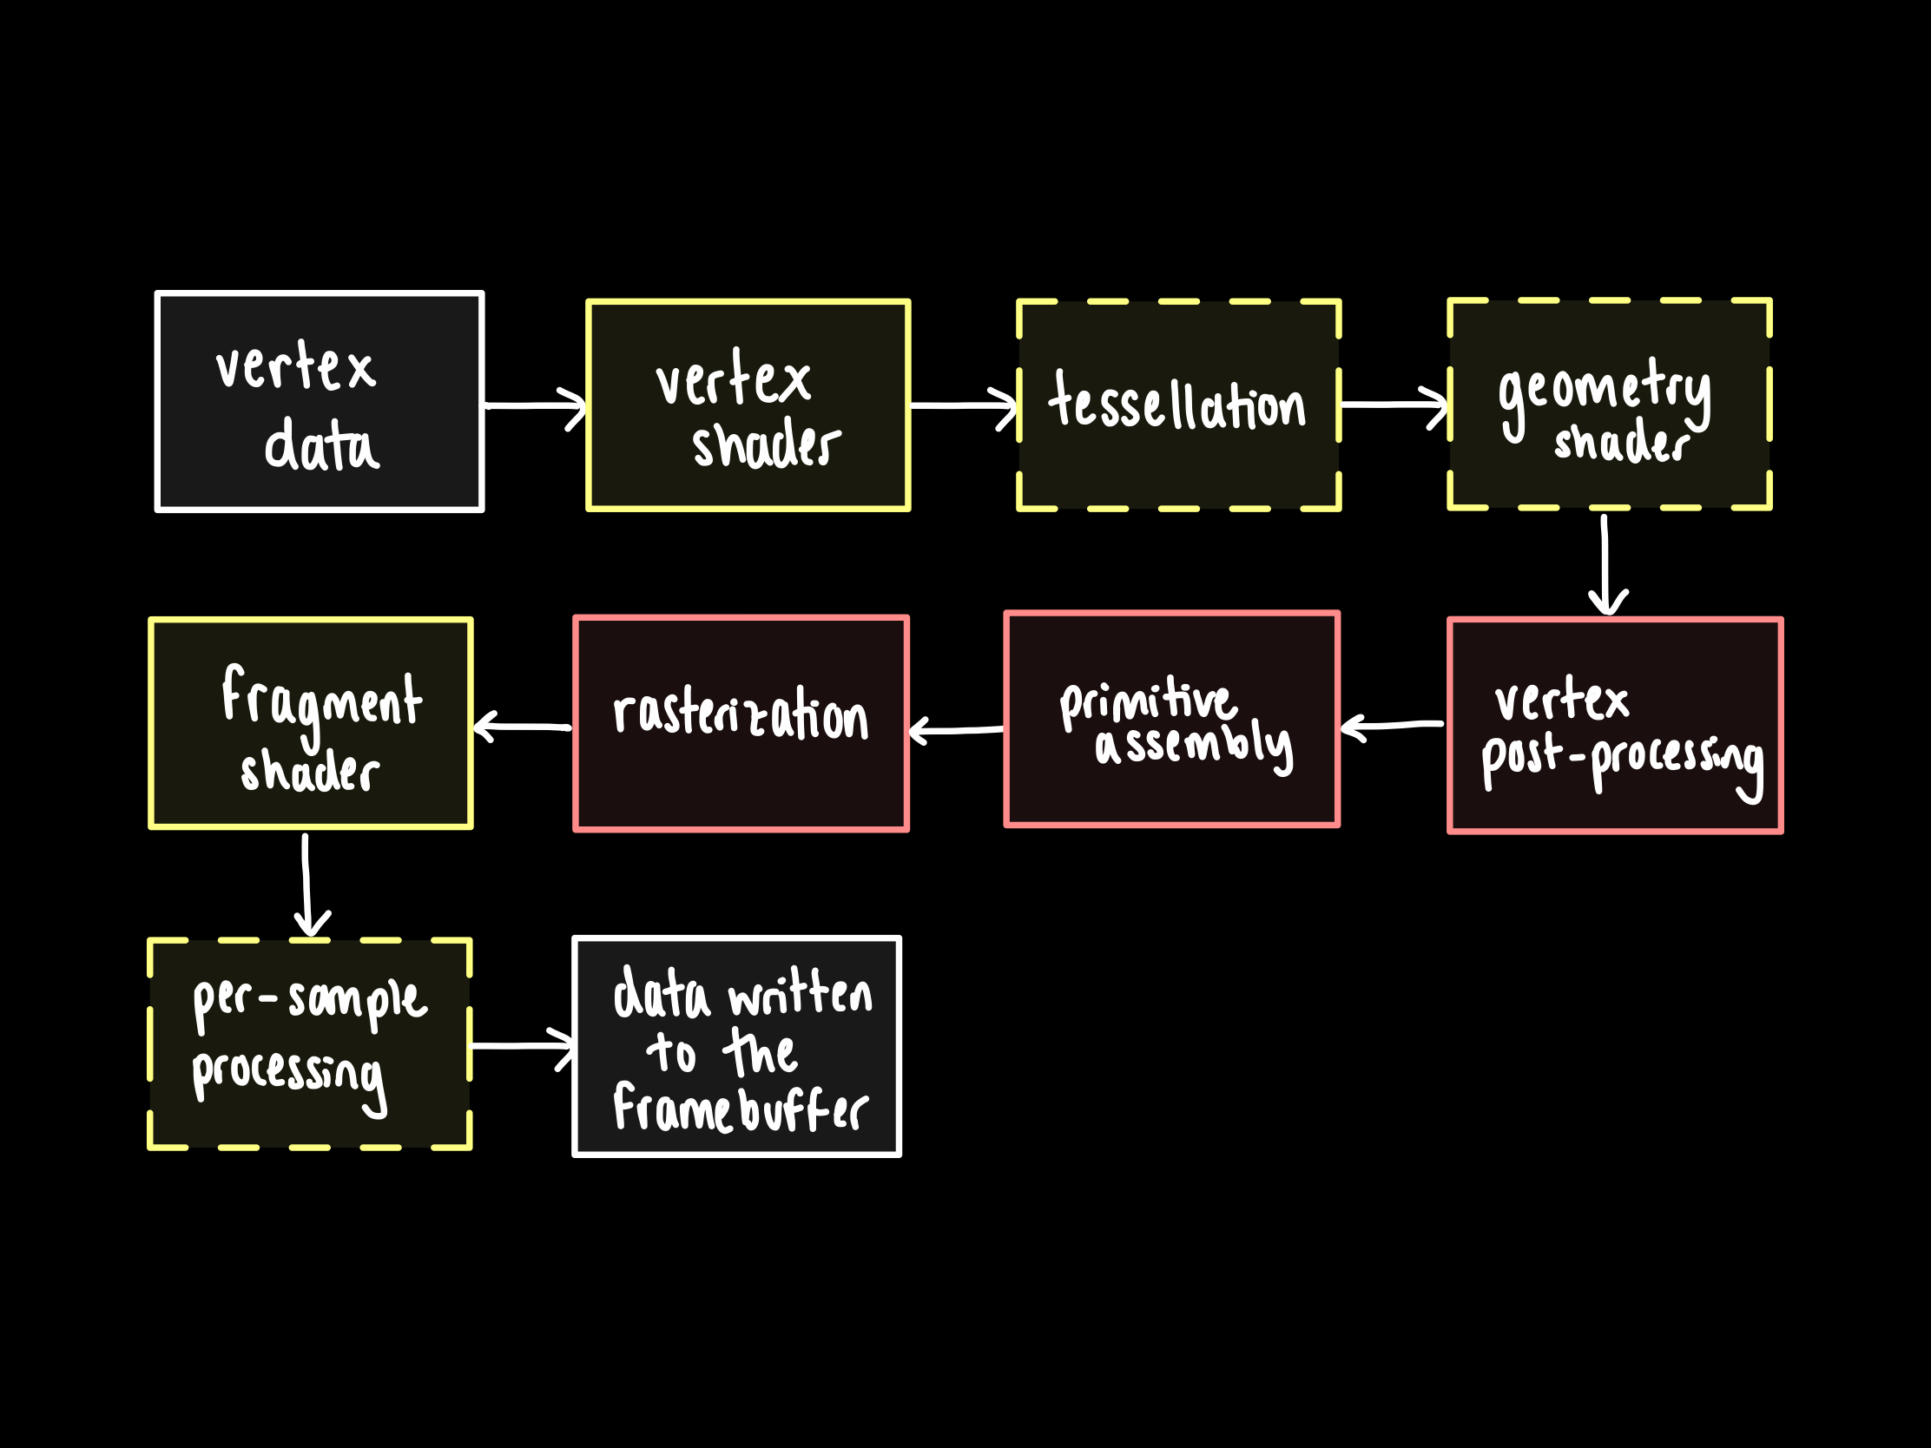
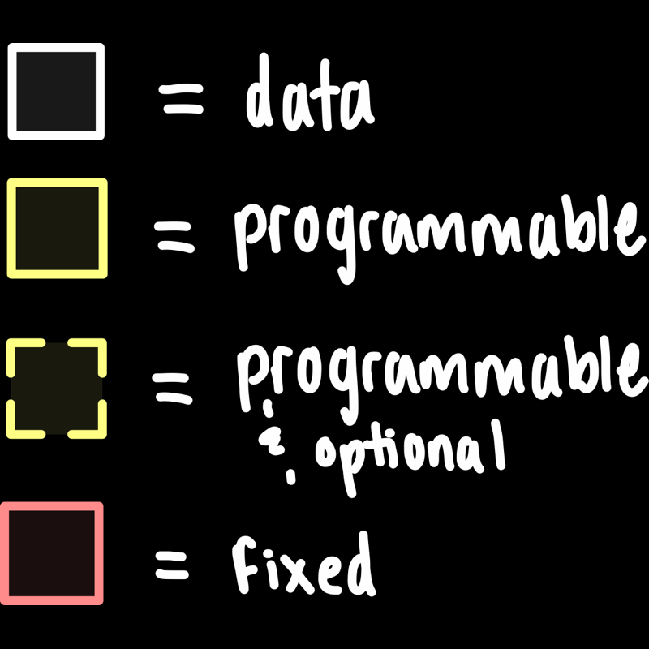
OpenGL rendering pipeline
Notes:
Set of fixed & programmable stages for processing geom data.
Start w/vertex data (position & other attribs e.g. tex cords, normal)….. process it, ending up w/fragm data (colour, depth & stencil) written to the currently active framebuffer -> this could be the screen buffer (img is rendered to screen) or another custom FBO.
FBO = an object which has a colour, depth & stencil buffers.
We’re mainly focussed on the vertex & fragment shaders here => NEXT SLIDE

Slide 6
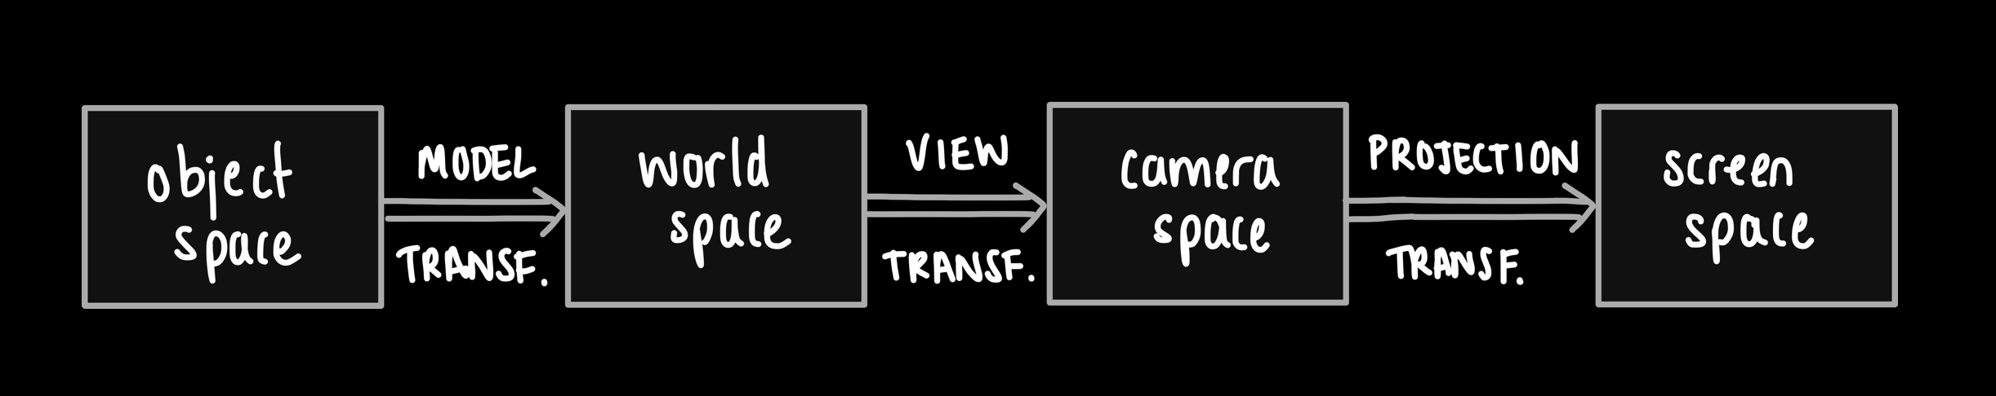
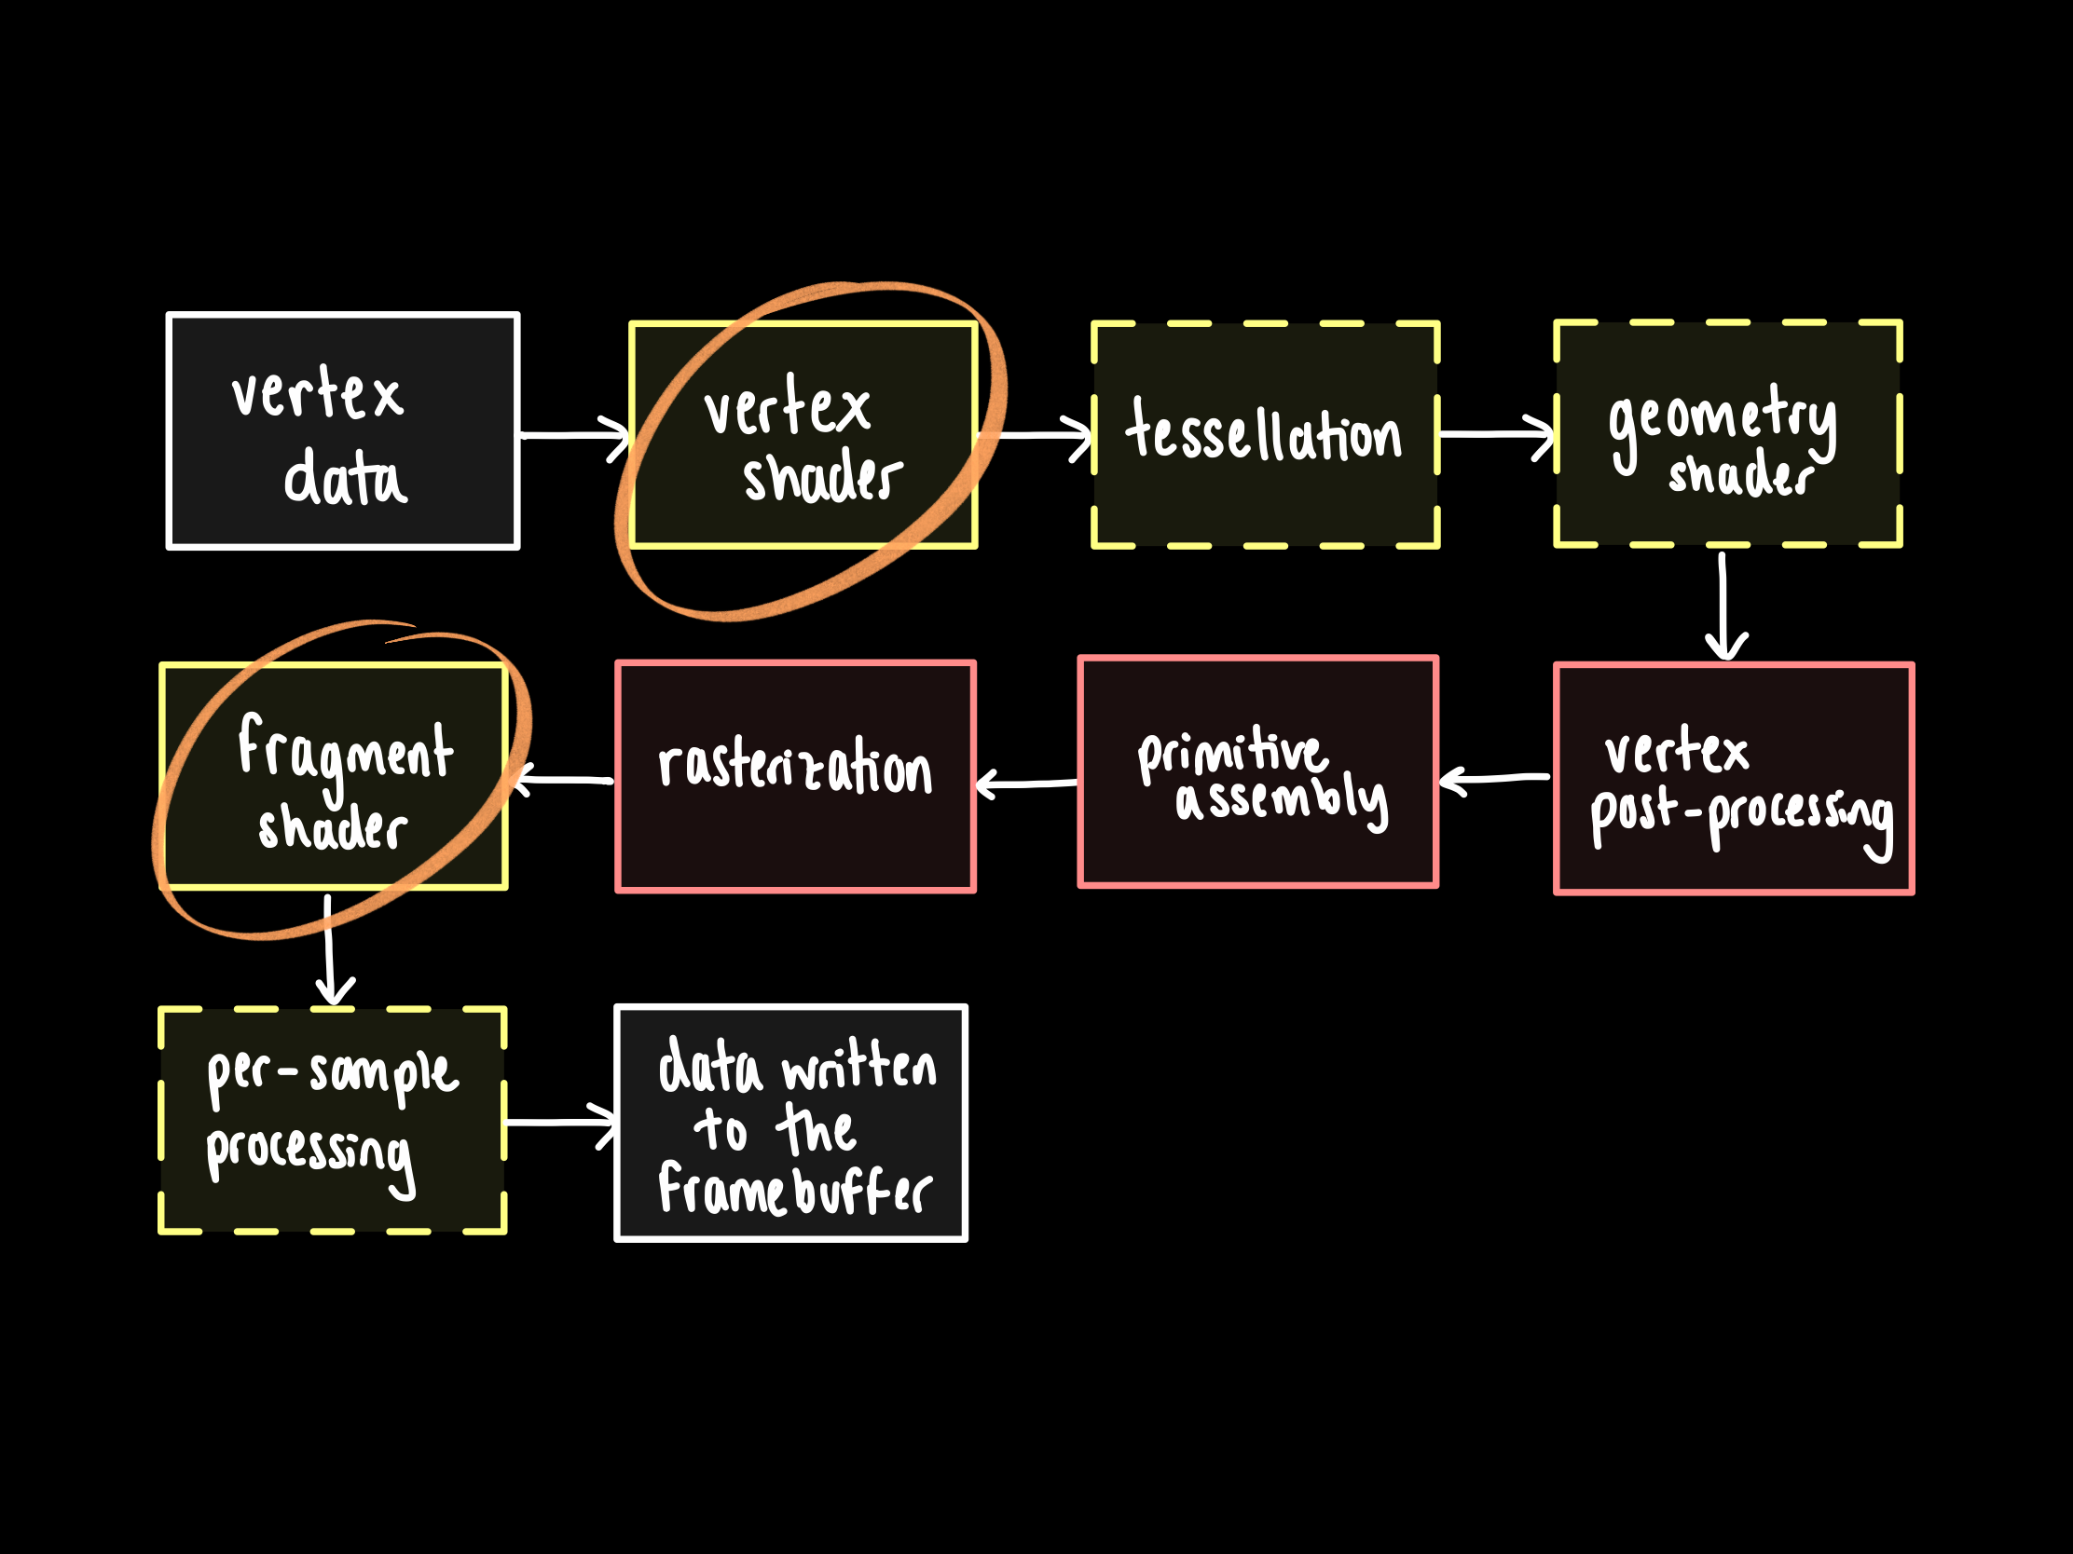

OpenGL rendering pipeline
Notes:
Vertex shader:
performs basic processing of each indiv vertex
converts each incoming vertex into a single outgoing vertex based on a user-defined prog.
[CLICK] do a series of transf to get from local obj coords to screen coords (obj space -> world space -> camera space -> screen space)

Slide 7
OpenGL rendering pipeline
Notes:
Fragment shader:
data for each fragment from the rasterization stage is processed by a fragment shader.
Calculates the colour for each fragment (pixel) e.g. using Phong illumination model.
[“fragment” = “candidate pixel”… might or not be the final pixel, depending e.g. whether there’s a closer fragment or not, e.g. any later per-sample processing (stencil test…)]
Output: a colour value, a depth value, & a stencil value.
Mention: it doesn’t know anything about scene itself (only info about current frag…) -> cannot have obj act on other obj shading! -> need shadow mapping [NEXT SLIDE]

Slide 8
Method (directional lights)
2 pass algorithm:
Generate Depth Map by rendering scene from light’s POV
Render scene from camera’s POV…
…using generated Depth Map to determine if fragment is lit
or in shadow

Slide 9
Method (directional lights)
2 pass algorithm:
Generate Depth Map by rendering scene from light’s POV
Render scene from camera’s POV…
…using generated Depth Map to determine if fragment is lit
or in shadow

Slide 10
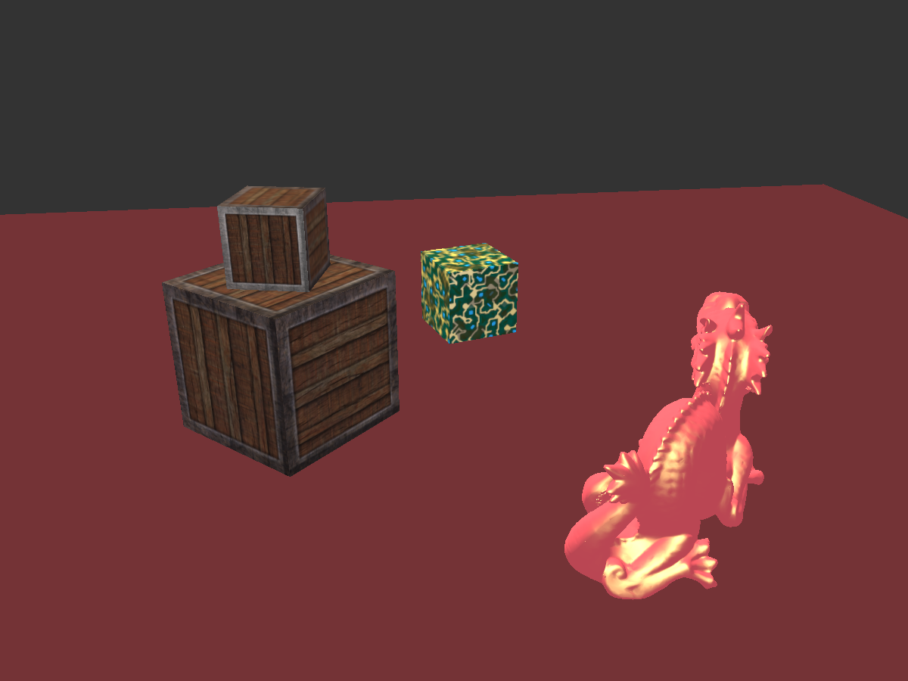
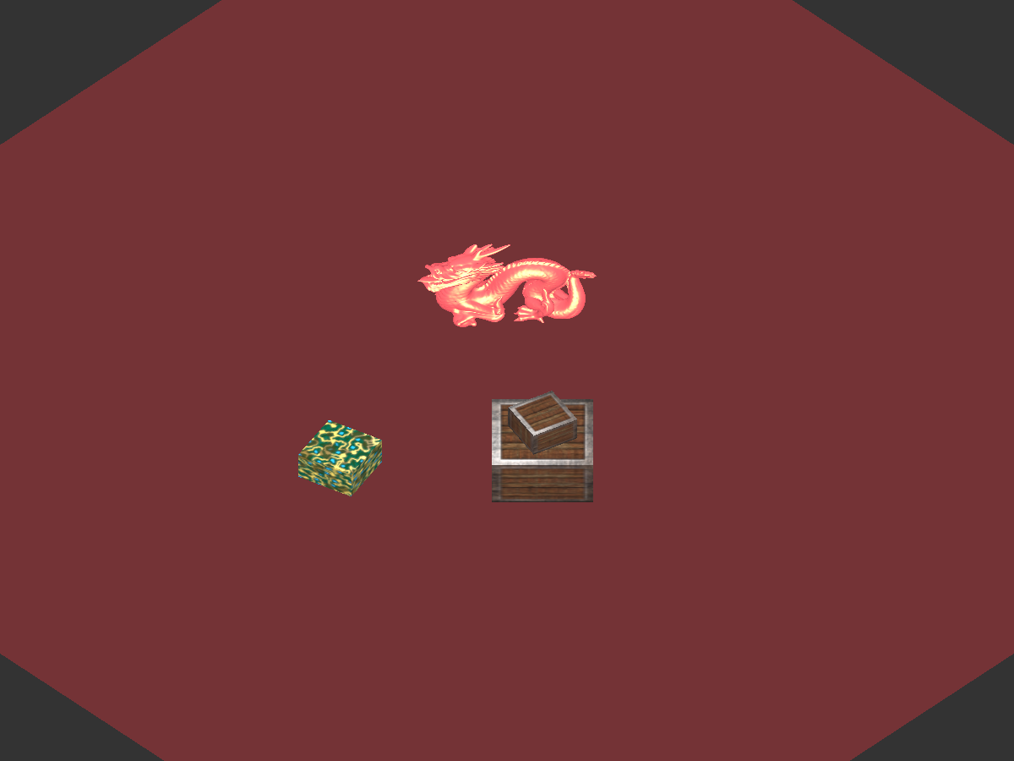
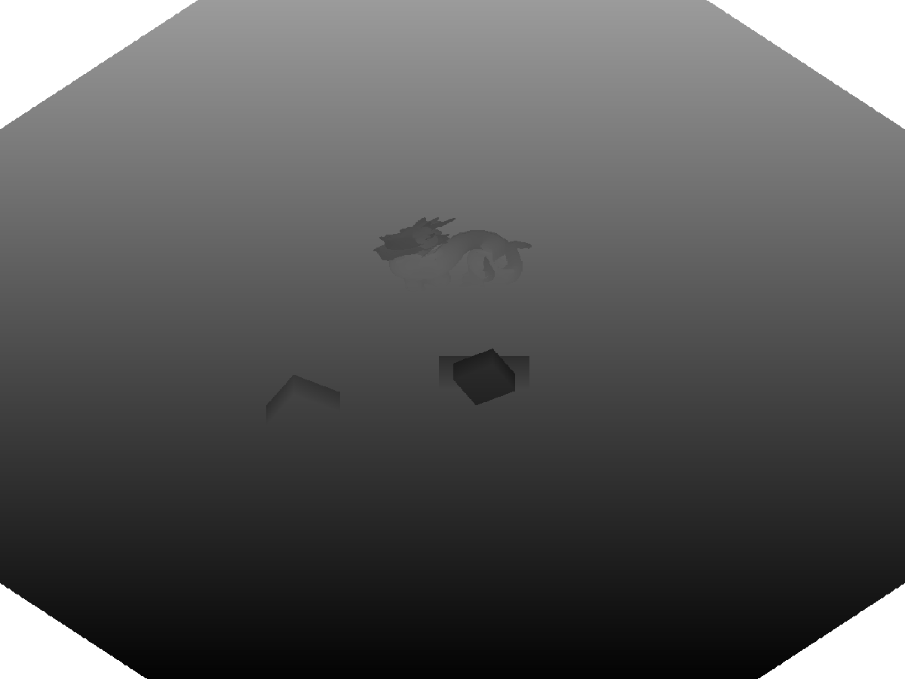
Step 1) generate depth map (1/2)
Render scene from light’s POV
Record depth values only (not colour)
Depth values stored in a depth buffer - This is our depth map!
So, depth map stores depth of the closest fragments as seen from the light’s perspective
Notes:
In shadow map: further away = whiter

Slide 11
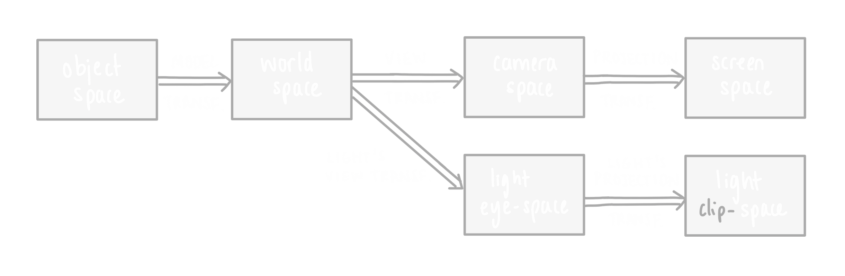
Step 1) generate depth map (2/2)
Create a texture object → our depth map.
Transform scene to light space

Slide 12
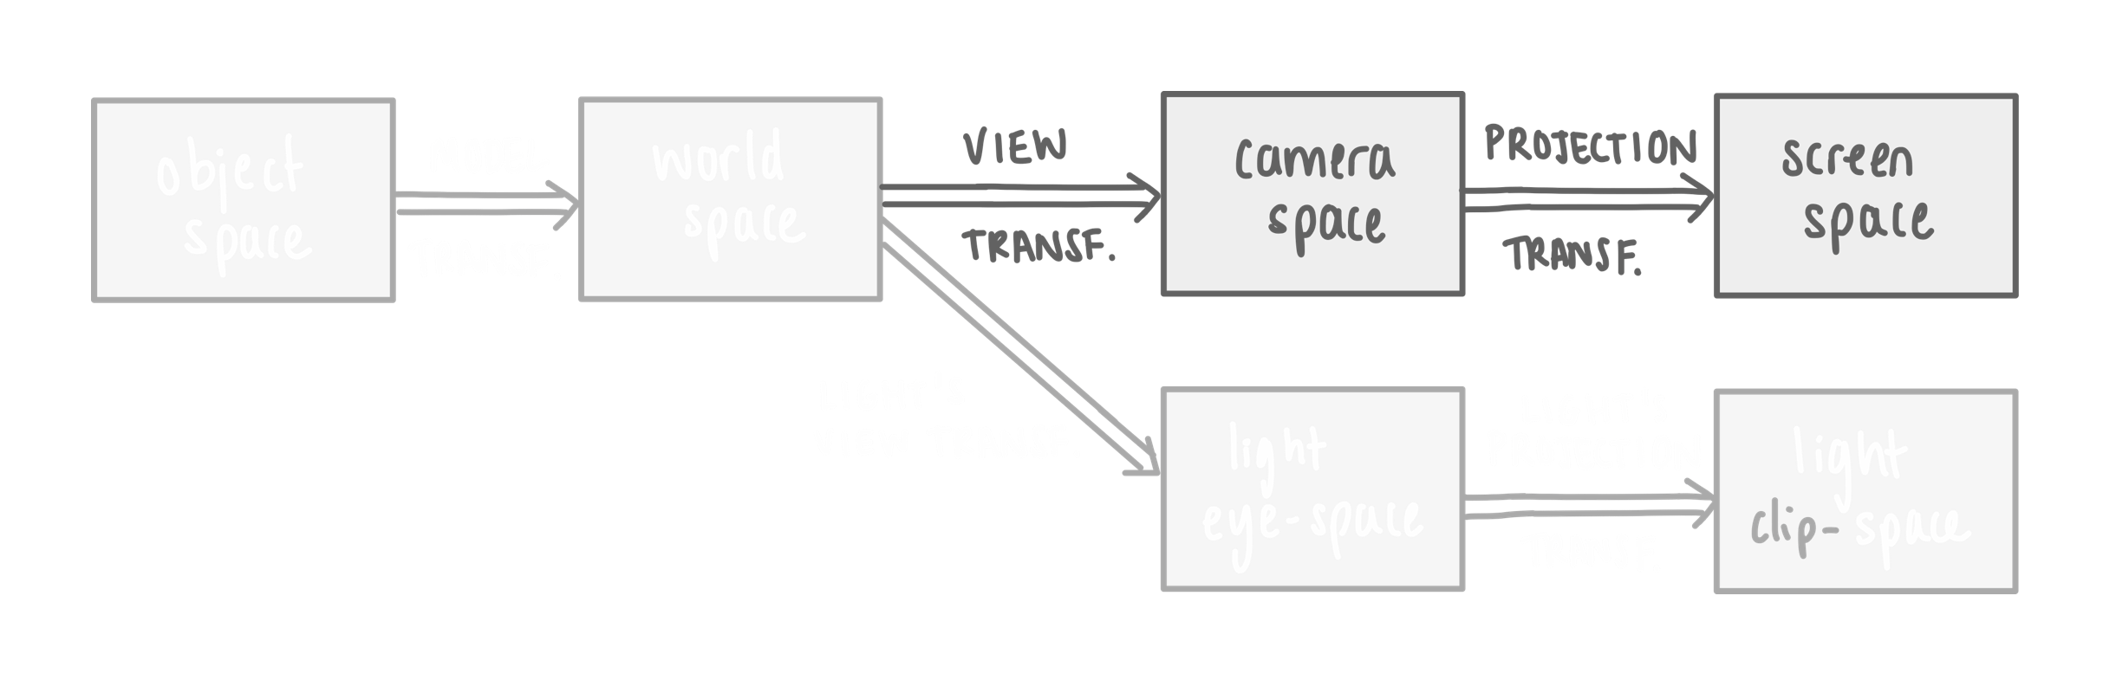
Step 1) generate depth map (2/2)
Create a texture object → our depth map.
Transform scene to light space

Slide 13
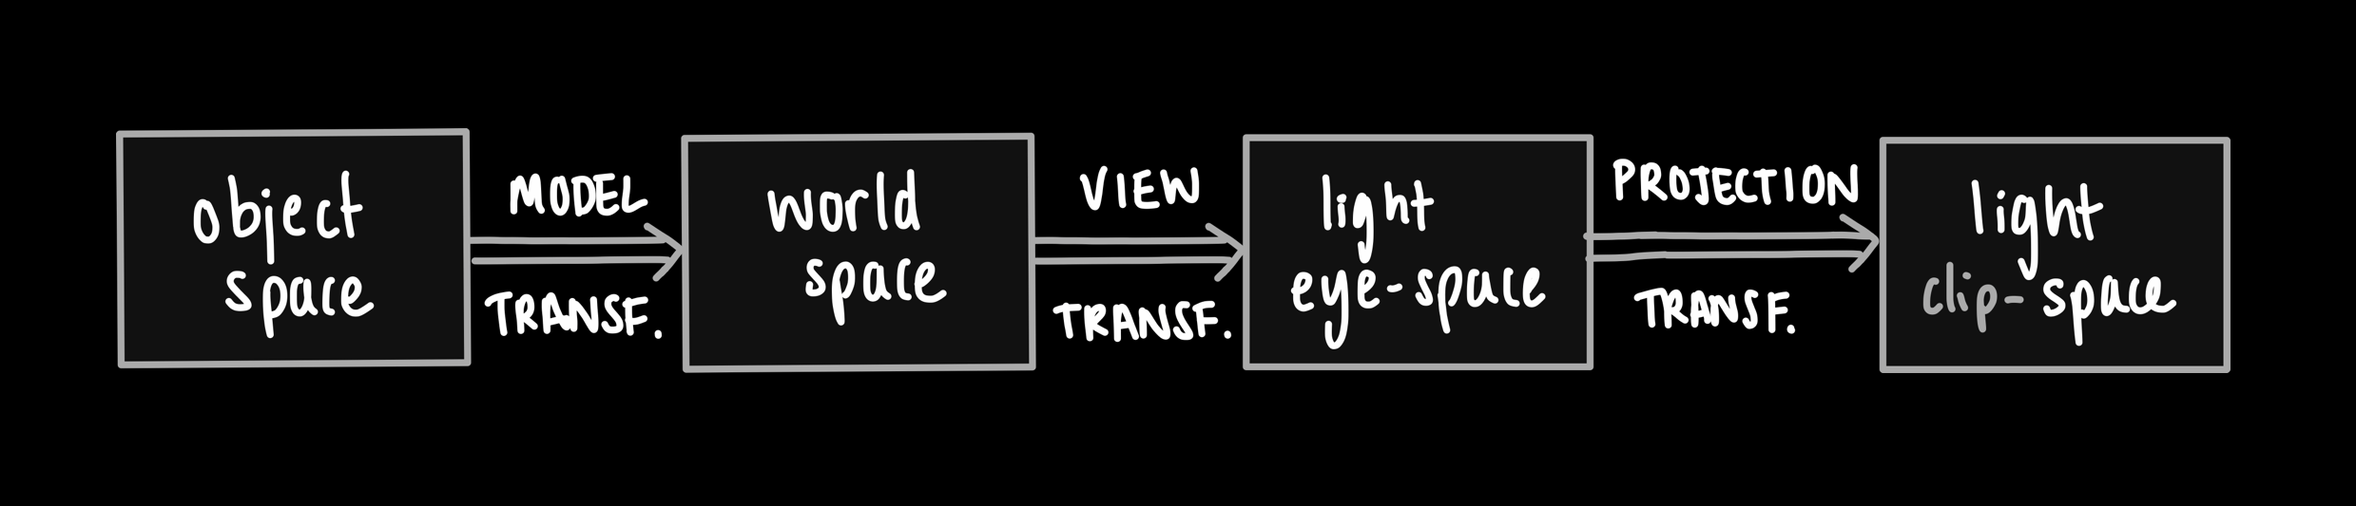
Step 1) generate depth map (2/2)
Create a texture object → our depth map.
Transform scene to light space
Use view & projection matrices specific to the light source
Then, calculate an MVP matrix to use in the vertex shader
Render to depth map
Vertex shader – transforms vertices to light space using calculated matrix
Fragment shader – empty, since no colour data

Slide 14
Method (directional lights)
2 pass algorithm:
Generate Depth Map by rendering scene from light’s POV
Render scene from camera’s POV…
…using generated Depth Map to determine if fragment is lit
or in shadow

Slide 15

Step 2) render scene (1/2)
Render scene as usual, from camera’s POV
Vertex shader
– transforms vertices to screen space (MVP matrix)
– also transforms them to light space → to be used in fragment shader *
Fragment shader
– determines colour of fragment (e.g. Phong)
– checks if lit or in shadow:
Samples corresponding point in depth map → depth of closest object to light, $z_{c}$
Compares with depth of fragment in light space (*), $z_{f}$
If $z_{f}>z_{c}⇒$ in shadow (not seen from light)

Slide 16
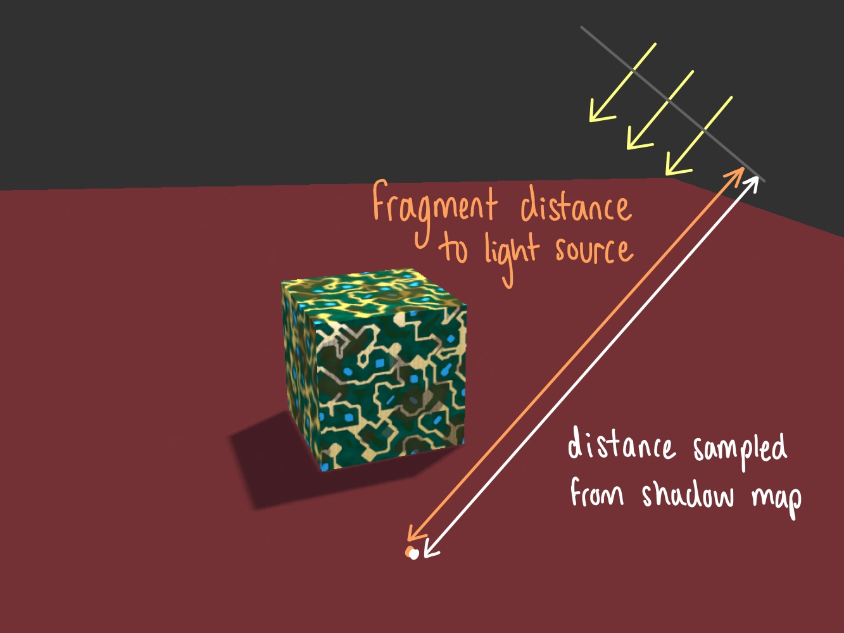
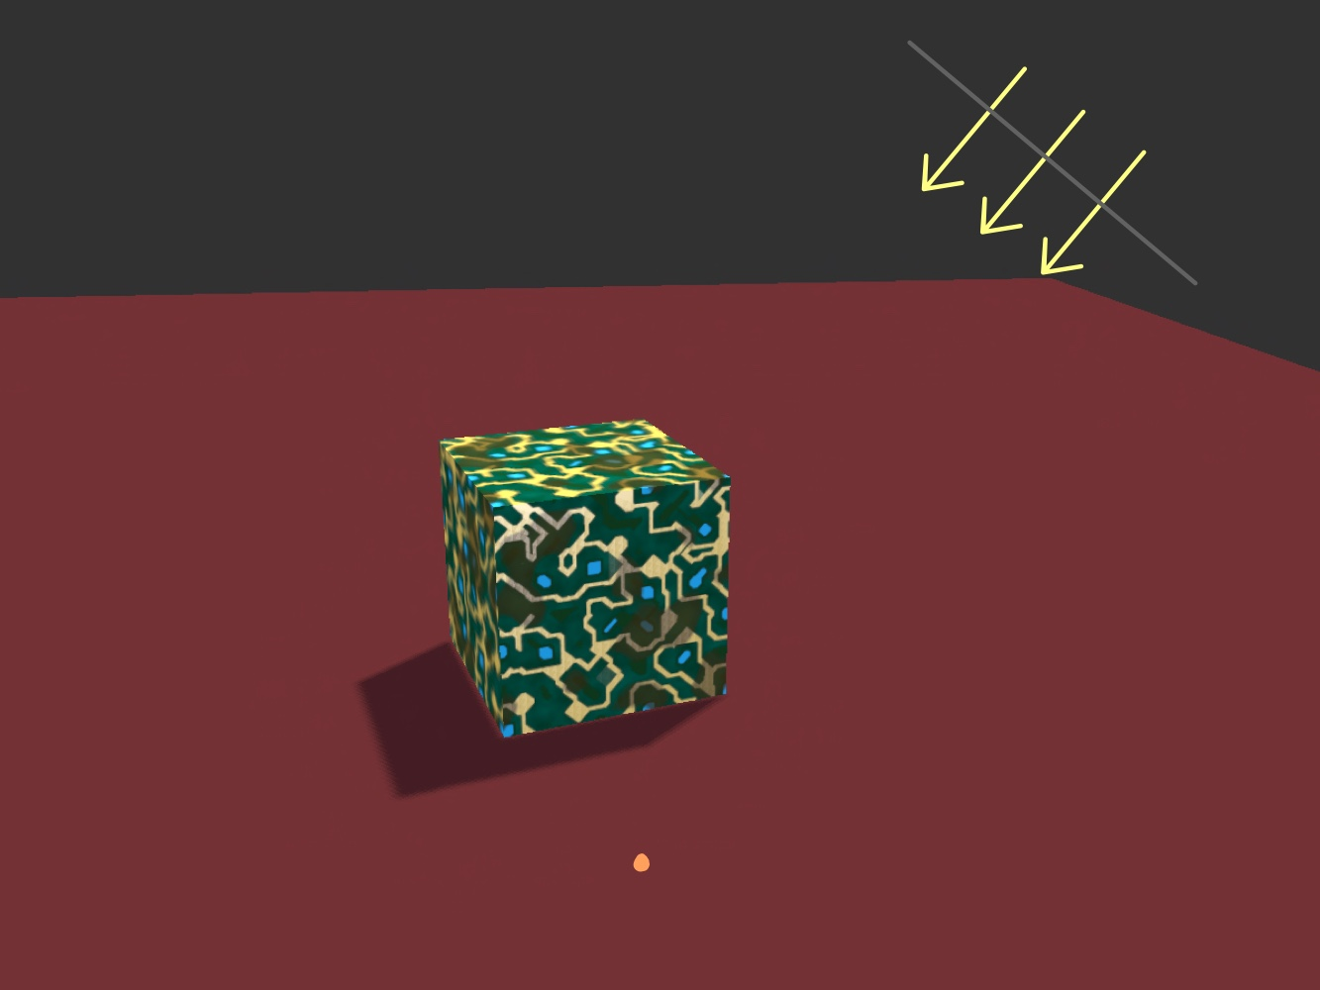
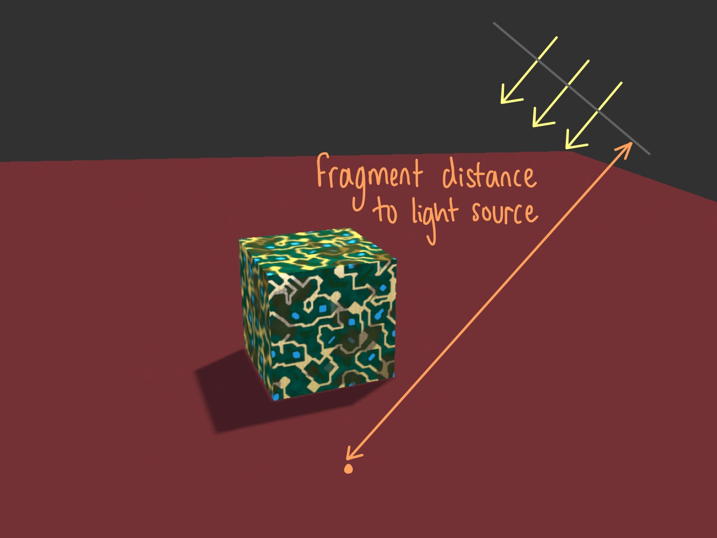
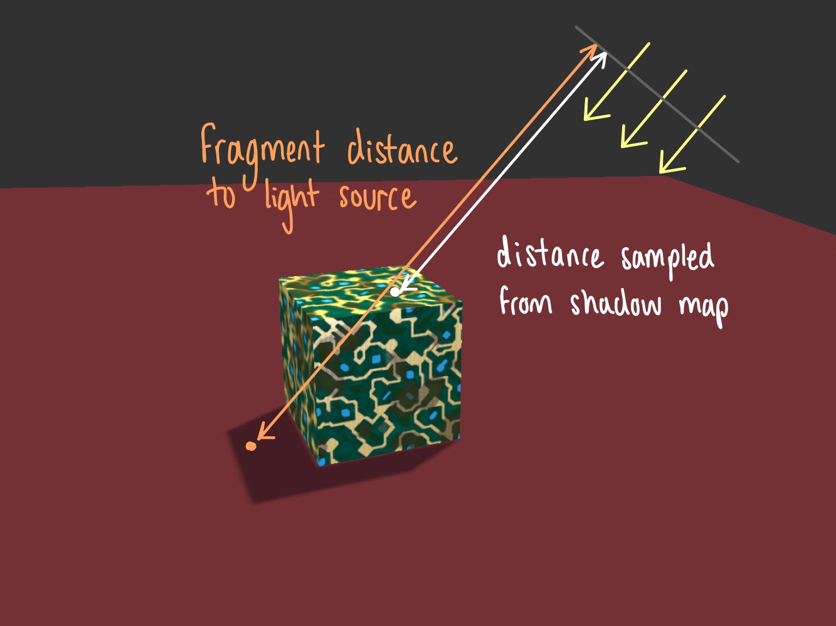
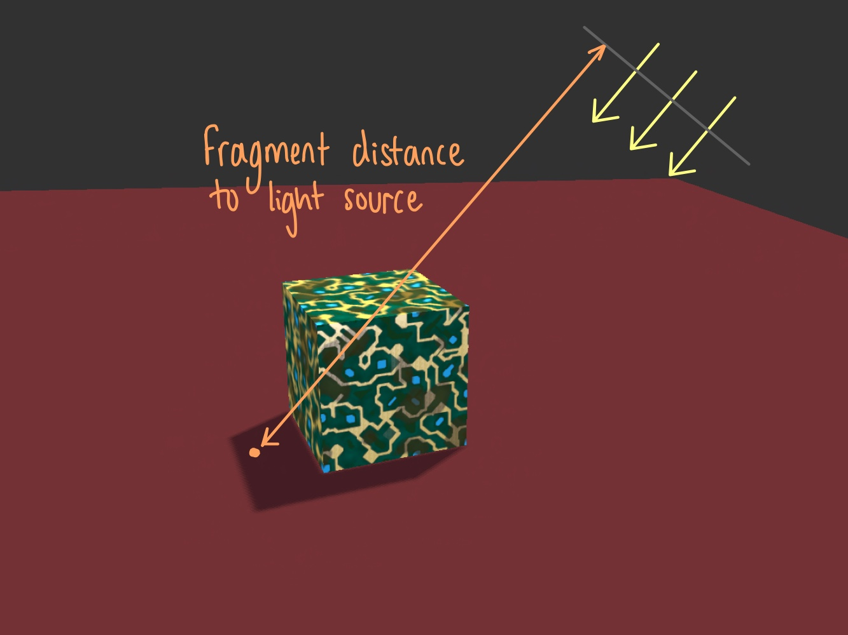
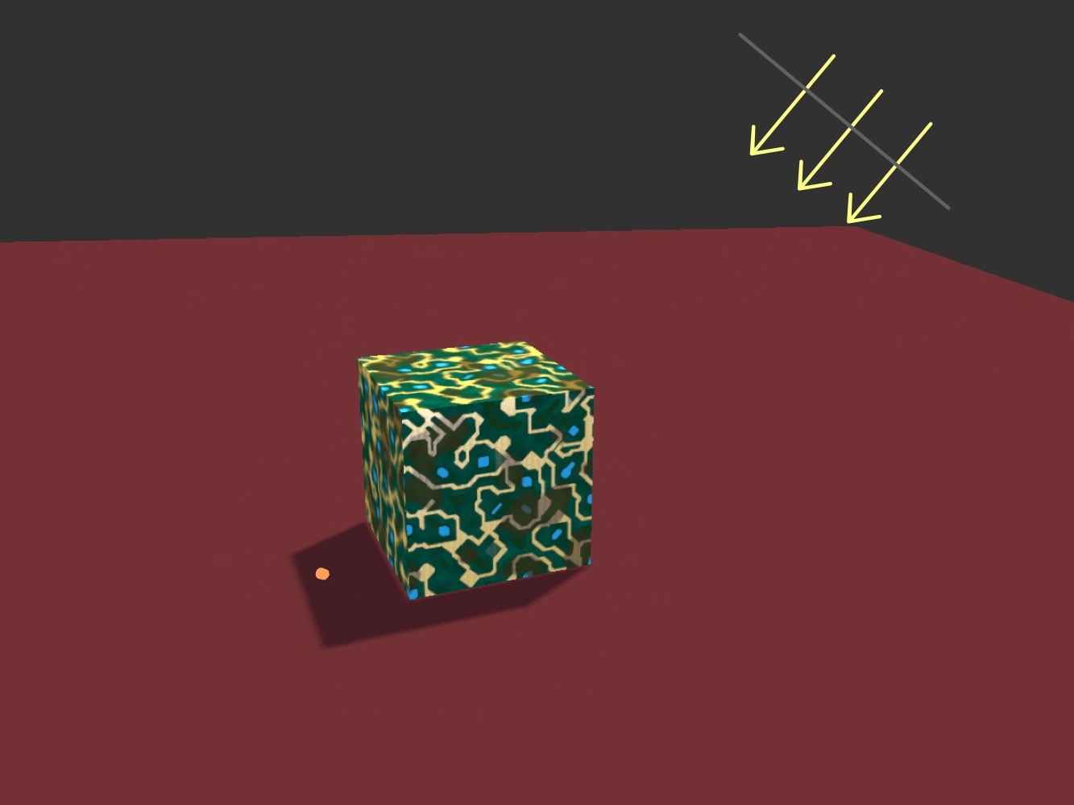

Step 2) render scene (2/2)
Fragment shader – checks if lit or in shadow:
Samples corresponding point in depth map → depth of closest object to light, $z_{c}$
Compares with depth of fragment in light space, $z_{f}$
If $z_{f}>z_{s}⇒$ in shadow (not seen from light)
e.g.1. Point not in shadow
e.g.2. Point in shadow
Notes:
TODO: img of the sample scene. Indicate depth (from light’s POV) of closest element (<- value stored in depth map…) & current frag
e.g.1. for a point that’s lit
e.g.2. for a point that’s in shadow

Slide 17
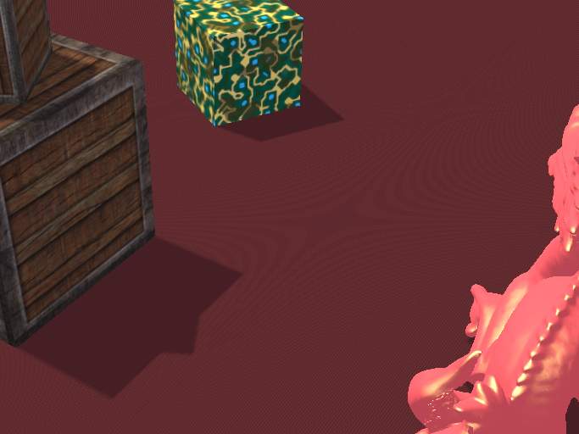


Artefacts
Shadow Acne
Moiré-like pattern
${Sol}^{n}$: apply small bias
Notes:
Shadow acne:
Due to the limited resolution of the shadow map => self shadowing:
[NEXT SLIDE]

Slide 18
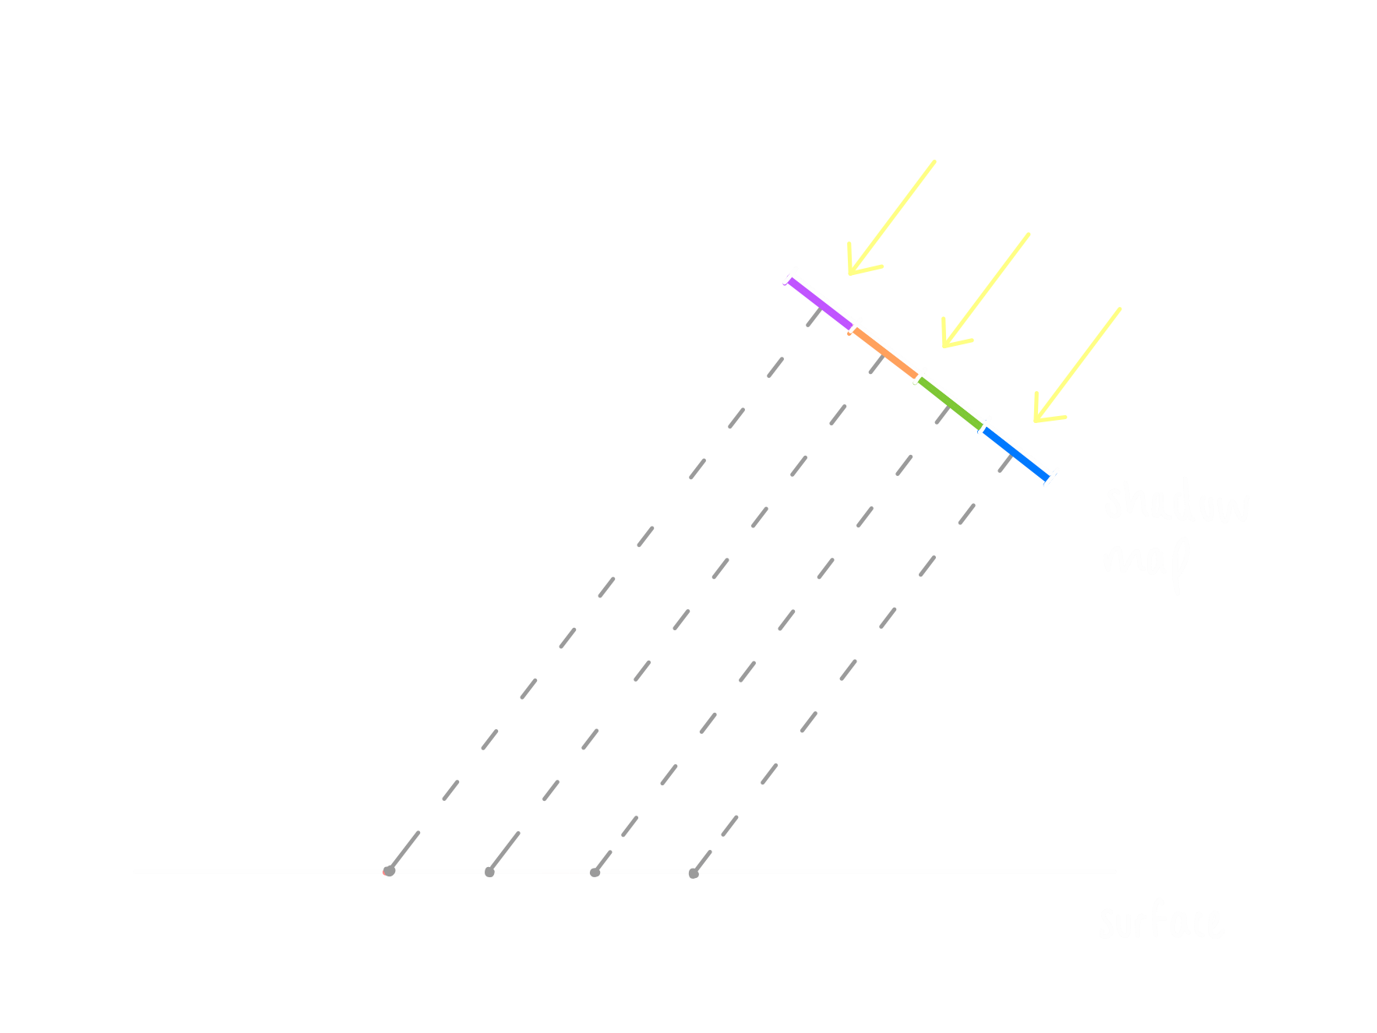
Artefacts
Shadow Acne
Moiré-like pattern
${Sol}^{n}$: apply small bias
Notes:
Have shadow map w/limited resolution
(finite nº of pixels… each stores depth corresponding to 1 point on surface…)
[NEXT SLIDE]

Slide 19
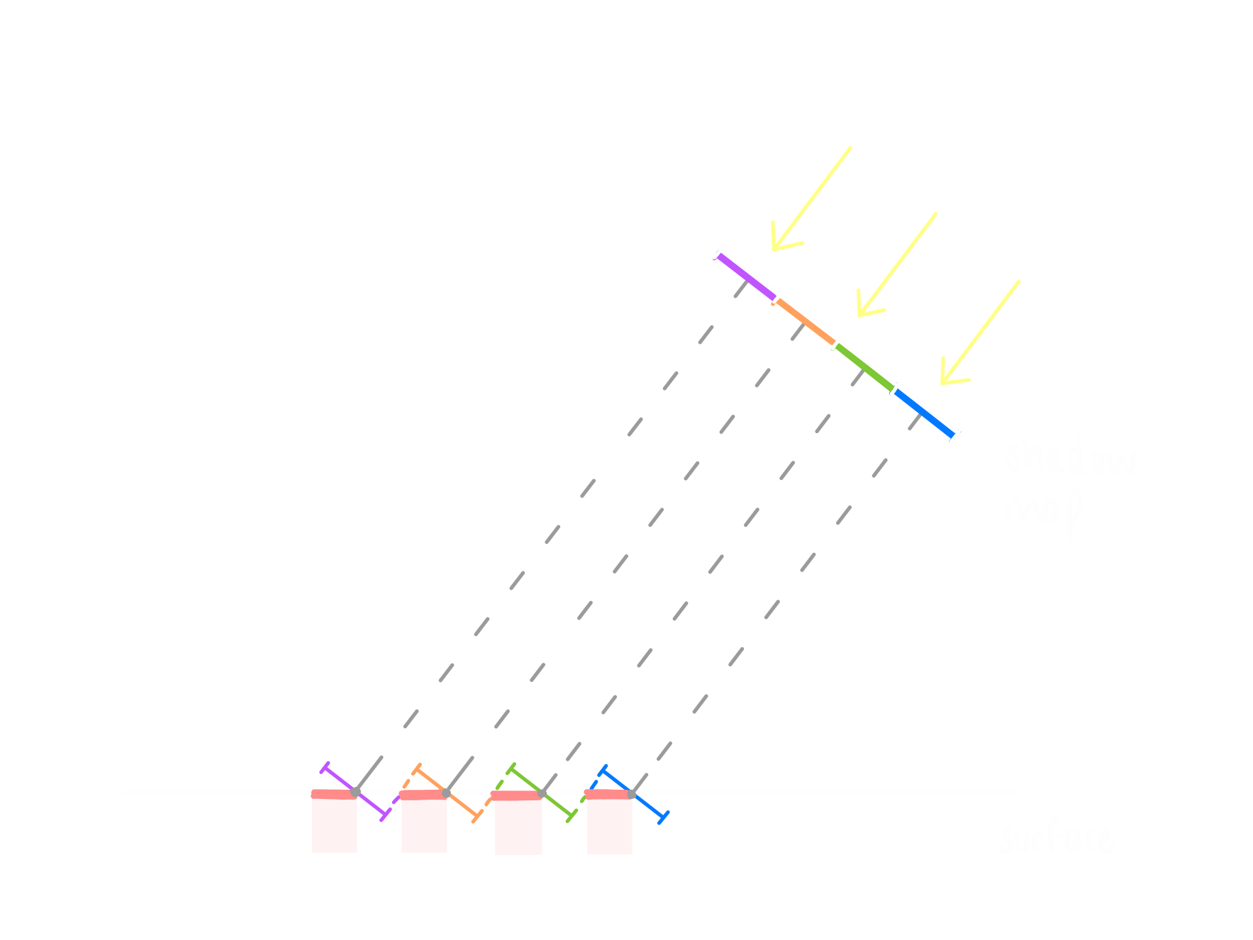
Artefacts
Shadow Acne
Moiré-like pattern
${Sol}^{n}$: apply small bias
Notes:
dif fragments will sample same texel (pixel of depth texture/map)
but some frags will have a depth slightly closer/further away… (surf is continuous; depth map discrete values…)
so some frags will be in shadow whilst others not
=> shadow discrepancy -> striped pattern
Soln [NEXT SLIDE]

Slide 20
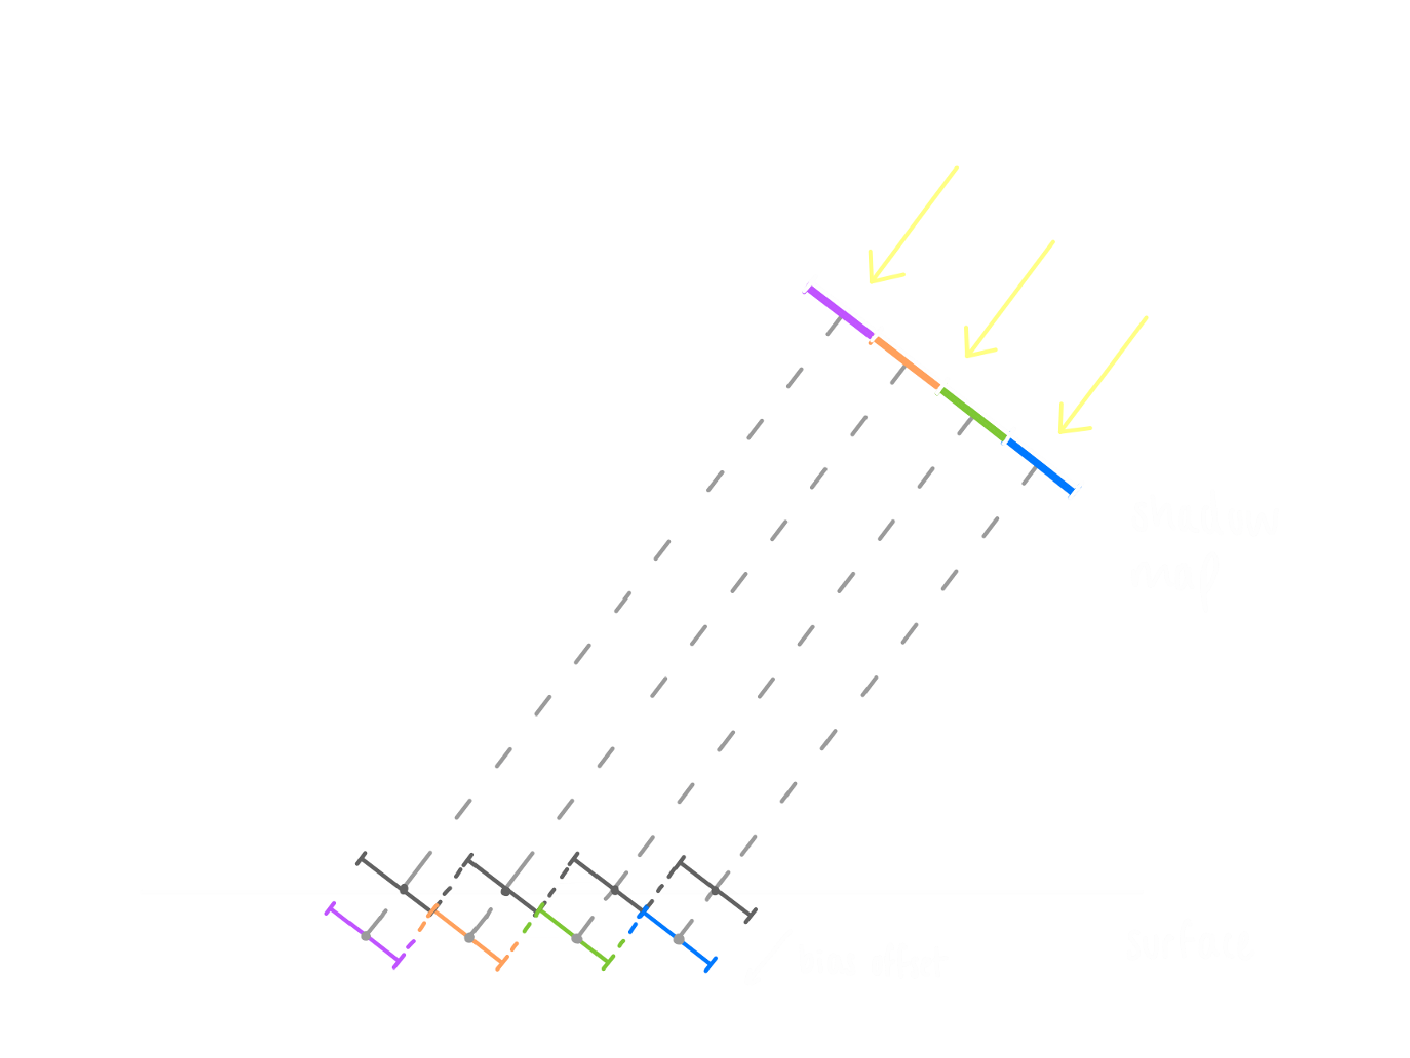
Artefacts
Shadow Acne
Moiré-like pattern
${Sol}^{n}$: apply small bias
Notes:
Soln: apply small bias -- offset depth of surface (or shadow map) by small bias amt s.t. frags are not incorrectly considered below surface
Amt depends on scene & angle towards light from the surface of the obj
Must be careful not to get “peter panning” (bias/offset big => shadow appears ‘detached’ to obj)

Slide 21
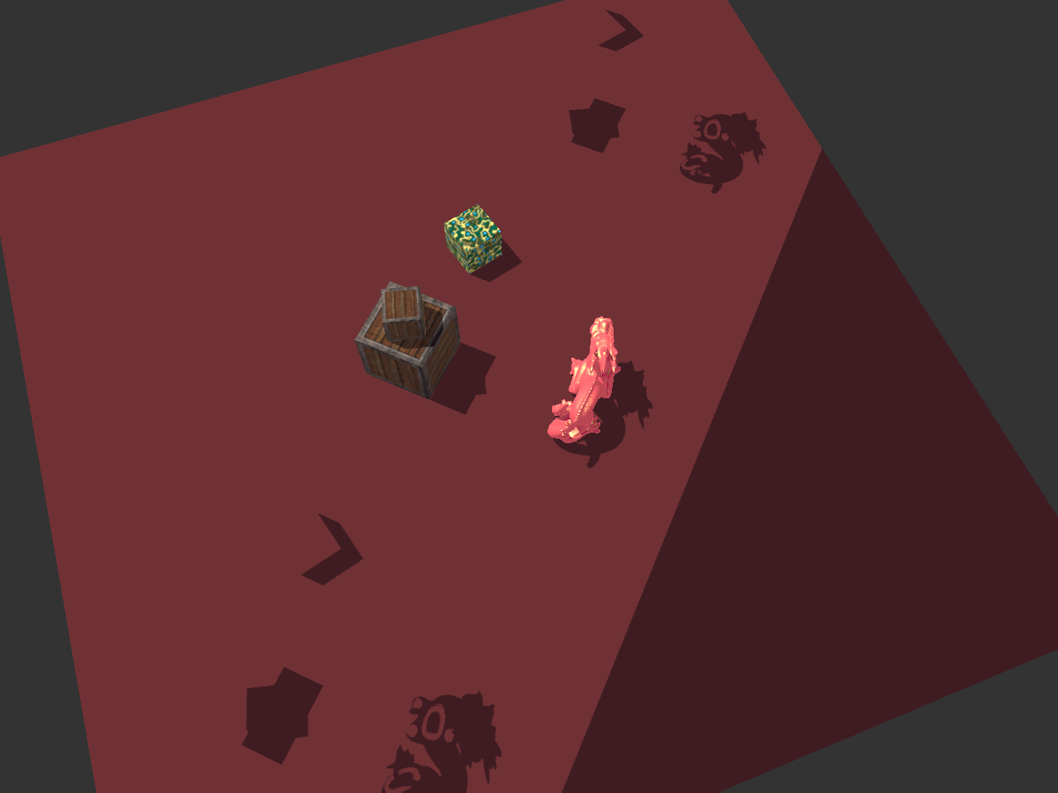

Artefacts
Shadow Acne
Moiré-like pattern
${Sol}^{n}$: apply small bias
Oversampling Issues
Points outside depth map appear in shadow
${Sol}^{n}$:
texture parameters
force fragments to be lit when $z_{f}>1.0$
Notes:
Oversampling issues
the following appear in shadow:
points outside size (width & height) of depth map
=> soln: add depth map a “tex border colour” set to white (so that depth = 1) & set tex obj param to GL_CLAMP_TO_BORDER
& points further away than depth map’s far plane (in the orthog. Projection)
=> soln: when calc if in shadow in frag shader, force points to be lit when z_f > 1.0

Slide 22
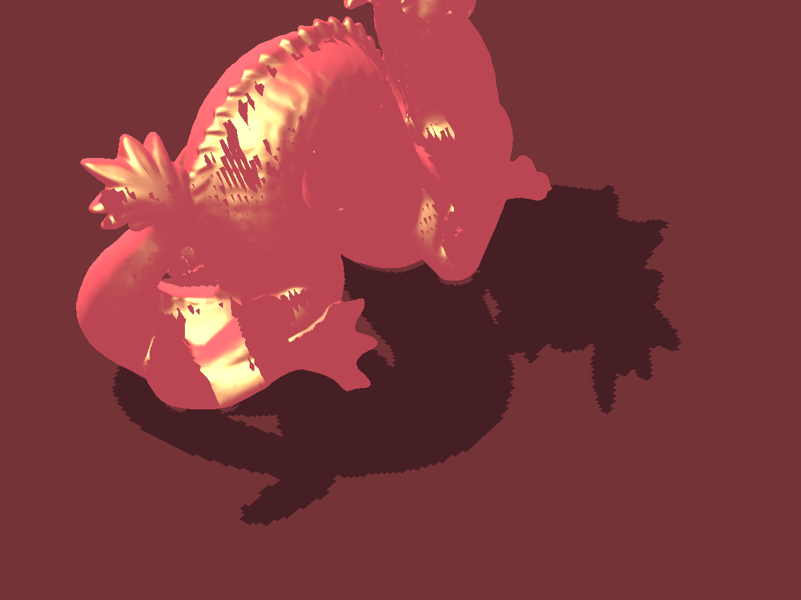

Artefacts
Shadow Acne
Moiré-like pattern
${Sol}^{n}$: apply small bias
Oversampling Issues
Points outside depth map appear in shadow
${Sol}^{n}$:
texture parameters
force fragments to be lit when $z_{f}>1.0$
Jagged Edges
Jagged, blocky edges to shadows
${Sol}^{n}$: Percentage Close Filtering (PCF)
Notes:
Jagged Edges
Due to the fixed resolution of the shadow map: multiple frags per texel (upsampling?)
Soln: PCF
set of techniques that produce softer shadows…
…by sampling >1 times from depth map, then combining/avg results to get soft shadow

Slide 23
Demo time! :)
Notes:
Demo structure:
show scene- simple, identify light source & where shadows would be
Show scene as seen from light
render shadow map in B&W onto a quad on the screen to visualise it
then render scene as usual w/shadows (eliminating all artefacts!!)<- has shadows, yay!

Slide 24
Shadow Mapping In Context
A Several advantages:
Fast on modern GPUs
Relatively easy to implement
Transparent Shadows
…and some drawbacks:
Aliasing!
…but many + advanced shadow mapping techniques improve this (at the expense of resources or flexibility)
e.g. Cascaded Shadow Maps, Percentage Closer Soft Shadows…
Omni-directional Shadow Mapping (for point lights) requires + renders
Notes:
Mention that there exist other techniques – shadow volumes
BUT S. Vols construct mesh to determine shadow… - takes time, bad as needs to be done every frame!!
(so adv of S.M. is that it’s fast...)
- Just mention advanced techniques, don’t explain / go into details….. !

Slide 25
Summary – key takeaways
A technique for rendering shadows in real-time 3D graphics
Shadows add realism, convey depth & convey spatial relationships between objects
Main foundation technique nowadays
Advanced techniques provide more accurate results
Many new ones being developed
Try to implement it!

Slide 26
Q&A – any questions?

